Slide 1


CMR TECHNICAL CAMPUS
UGC AUTONOMOUS
Accredited by NBA & NAAC with ‘A’ Grade
Approved by AICTE, New Delhi and JNTU, Hyderabad
Kandlakoya , Medchal Road, Hyderabad- 501 401, Telangana
Department of Computer Science And Engineering
WATER QUALITY MONITORING AND FORECASTING SYSTEM
MINI PROJECT REVIEW
BATCH NO :12
PROJECT GUIDE:
K.PRAVEEN KUMAR
(ASSISTANT PROFESSOR)
PRESENTED BY:
K.VINAY KUMAR REDDY 207R1A0589
CH.NARESH 207R1A0572
B.VENKAT SAI 207R1A0568

Slide 2
CONTENTS
ABSTRACT
EXISTING SYSTEM
EXISTING SYSTEM DISADVANTAGES
PROPOSED SYSTEM
PROPOSED SYSTEM ADVANTAGES
REQUIREMENTS SPECIFICATION
NOVELTY
ARCHITECTURE
MODULES
UML DIAGRAMS
SAMPLE CODE
RESULTS
CONCLUSION
REFERENCES
FUTURE SCOPE
GITHUB LINK

Slide 3
ABSTRACT
Water quality is crucial for survival but can be affected by factors like industrialization, mining, pollution, and natural occurrences.
Machine Learning (ML) tools are applied to automatically determine the suitability of water samples for drinking and irrigation.
Three ML models - Random Forest (RF), Logistic Regression (LR), and Support Vector Machine (SVM) - are compared for water classification.
Recursive feature elimination identifies the key water parameters influencing the accuracy of the ML models.

Slide 4
EXISTING SYSTEM
Water Monitoring Stations are equipped with sensors and instruments to measure various water parameters. These parameters include physico-chemical measurements such as pH, dissolved solids, metals like zinc and lead, as well as microbiological measurements. The stations collect data on these parameters at regular intervals.
It uses statistical analysis techniques to analyze the collected data from the monitoring stations is then analyzed to assess the quality of the water

Slide 5
EXISTING SYSTEM DISADVANTAGES
An existing methodology doesn’t implement DATA PRE-PROCESSING & LABELLING method.
Less Accuracy

Slide 6

PROPOSED SYSTEM
Develop a network for real-time collection and monitoring of water quality in Cape Town's water storage dams and treatment plants, accounting for unique geographical features like mountains and elevations that can impact radio frequency propagation.
Curate comprehensive datasets on drinking and irrigation water, ensuring they are of sufficient size to effectively train and test machine learning models. These datasets will enable automatic determination of water suitability for drinking and irrigation purposes.
Construct machine learning models that identify the most critical parameters influencing the accuracy of water analysis for drinking or irrigation. This analysis will help prioritize key factors in determining water fitness for specific uses.

Slide 7
PROPOSED SYSTEM ADVANTAGES
The purpose of WaterNet is to gather data on water parameters from dams across the city. These parameters are then used to assess the quality of water with regards ``fitness for use'' for drinking and irrigation purposes.
In this work, rather than relying on instrumental and physico-chemical analysis carried out in laboratories to assess water parameters, we propose the use of machine learning (ML) models, which take the numerous water parameters into consideration and automatically determine if a sample of water is potable or fit for agricultural use.

Slide 8

REQUIREMENTS SPECIFICATION
HARDWARE REQUIREMENTS
Processor : Pentium –IV
RAM : 4 GB (min)
Hard Disk : 20 GB
Key Board : Standard Windows Keyboard
Mouse : Two or Three Button Mouse
Monitor : SVGA
SOFTWARE REQUIREMENTS
Operating system : Windows 7 Ultimate.
Coding Language : Python.
Front-End : Python.
Back-End : Django-ORM
Designing : Html, css, javascript.

Slide 9
NOVELTY
Specialized Dataset Curation: The system aims to curate ample-sized datasets specifically focused on drinking and irrigation water. This specialized dataset collection allows for the training and testing of machine learning models to automatically determine the "fitness for use" of water samples and improves the accuracy of water quality assessments.

Slide 10
LIST OF MODULES
SERVICE PROVIDER
VIEW AND AUTHORIZE USERS
REMOTE USER

Slide 11
MODULES
SERVICE PROVIDER
Service Provider logs in with valid credentials to perform operations such as browsing and training water data sets, viewing accuracy results, predicting water quality, and accessing user information.
VIEW AND AUTHORIZE USERS
In this module, the admin can view the list of users who all registered. In this, the admin can view the user’s details such as, user name, email, address and admin authorizes the users.
REMOTE USER
Remote User module allows registration and login for multiple users. After successful registration, user details are stored in the database. Once logged in, users can perform operations like register and login, predict water quality detection type, and view their profile.

Slide 12
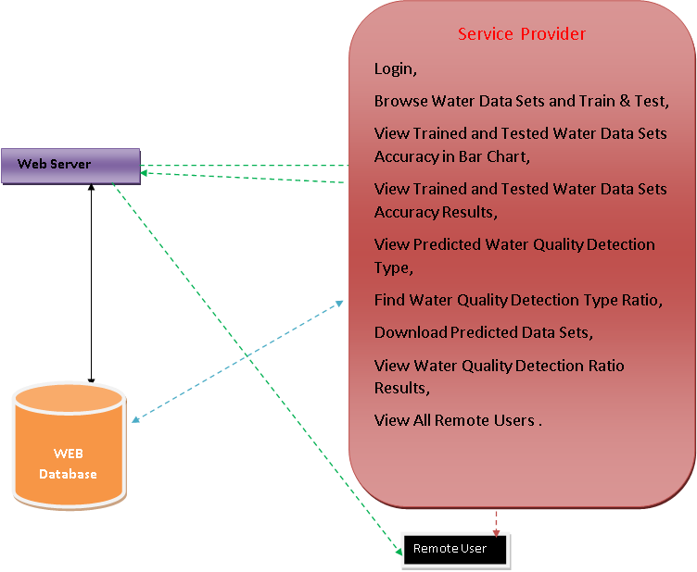
ARCHITECTURE
Accepting all Information
Datasets Results Storage
Accessing Data
Process all user queries
Store and retrievals
REGISTER AND LOGIN,
PREDICT WATER QUALITY DETECTION TYPE,
VIEW YOUR PROFILE.

Slide 13
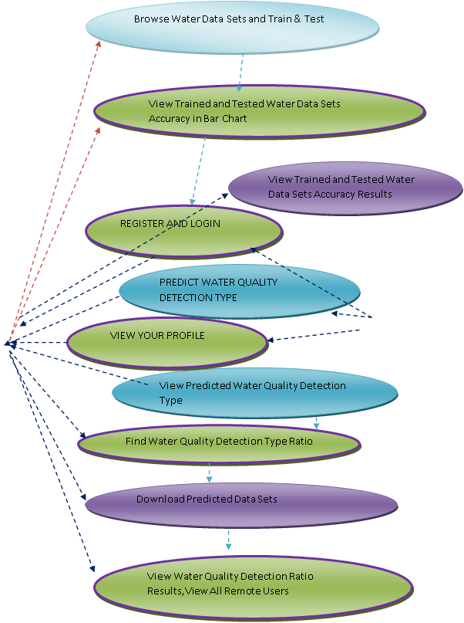


USE CASE DIAGRAM
SERVICE PROVIDER
REMOTE USER

Slide 14
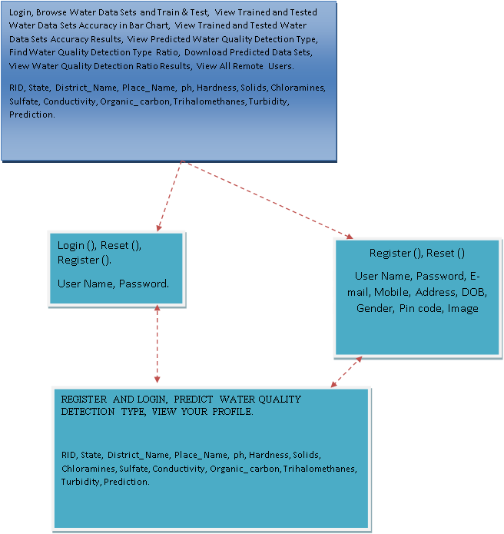
CLASS DIAGRAM
Service Provider
Login
Register
Remote User

Slide 15
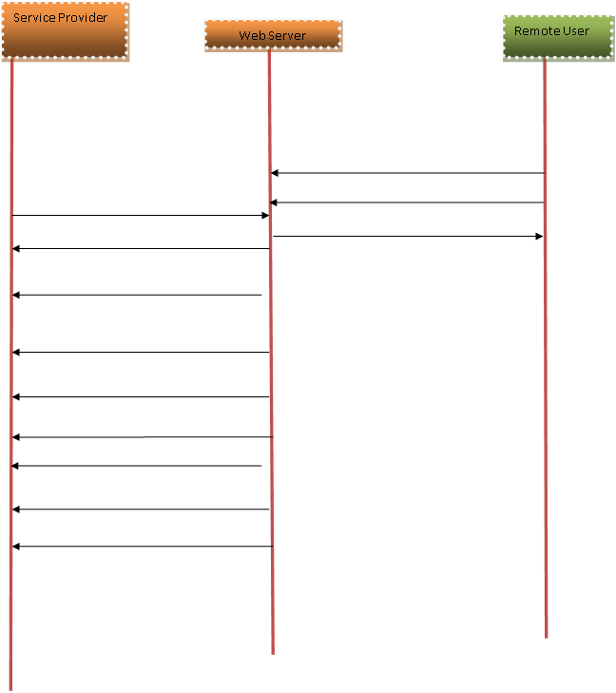
SEQUENCE DIAGRAM
REGISTER AND LOGIN
Login,
PREDICT WATER QUALITY DETECTION TYPE
Browse Water Data Sets and Train & Test,
VIEW YOUR PROFILE
View Trained and Tested Water Data Sets Accuracy in Bar Chart,
View Trained and Tested Water Data Sets Accuracy Results,
View Predicted Water Quality Detection Type,
Find Water Quality Detection Type Ratio,
Download Predicted Data Sets,
View Water Quality Detection Ratio Results,
View All Remote Users.
X
X
X

Slide 16
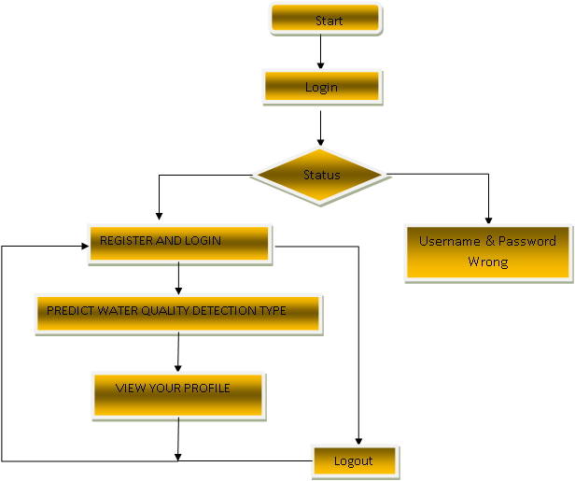
ACTIVITY DIAGRAM
REMOTE USER
YES
NO

Slide 17
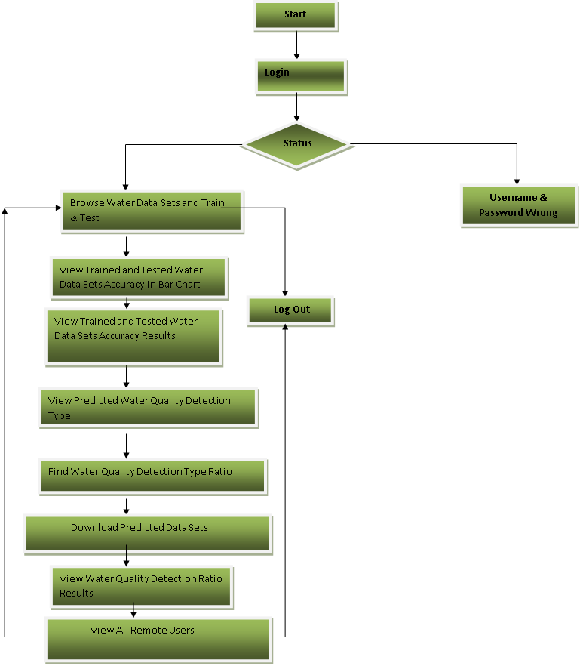
ACTIVITY DIAGRAM
SERVICE PROVIDER
YES
NO

Slide 18
SAMPLE CODE
#!/usr/bin/env python
"""Django's command-line utility for administrative tasks."""
import os
import sys
def main():
"""Run administrative tasks."""
os.environ.setdefault('DJANGO_SETTINGS_MODULE', 'waternet.settings')
try:
from django.core.management import execute_from_command_line
except ImportError as exc:

Slide 19
raise ImportError(
"Couldn't import Django. Are you sure it's installed and "
"available on your PYTHONPATH environment variable? Did you "
"forget to activate a virtual environment?"
) from exc
execute_from_command_line(sys.argv)
if __name__ == '__main__':
main()

Slide 20
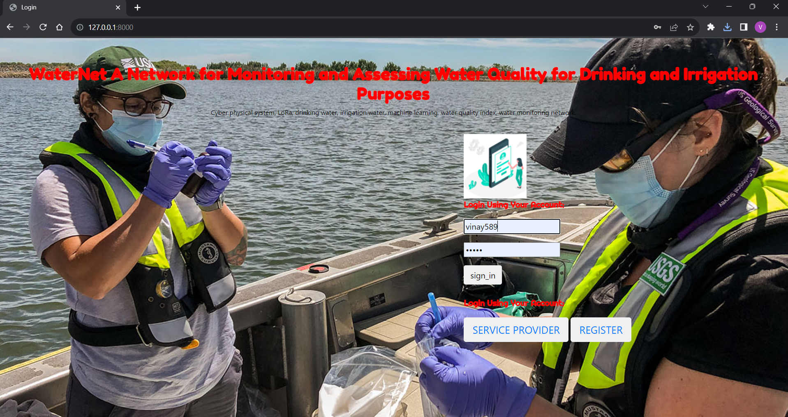
RESULTS

Slide 21
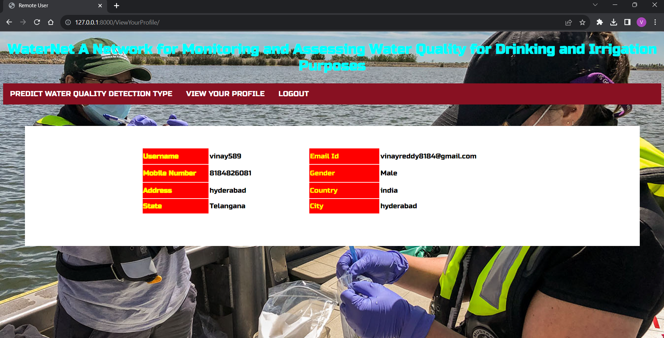

Slide 22
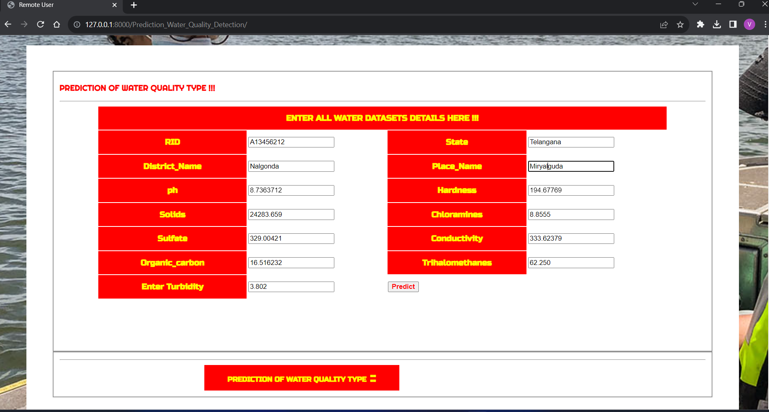

Slide 23
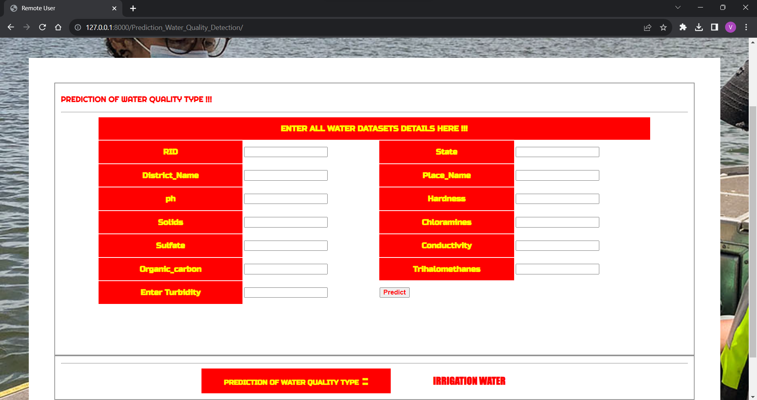

Slide 24
CONCLUSION
Proposed real-time water monitoring network for data collection and ML models for water quality assessment.
Developed and utilized datasets to train and test RF, LR, and SVM ML models.
LR showed superior performance for drinking water classification, while SVM was more suitable for irrigation water.

Slide 25
REFERENCES
[1] B. X. Lee, F. Kjaerulf, S. Turner, L. Cohen, P. D. Donnelly, R. Muggah, R. Davis, A. Realini, B. Kieselbach, L. S. MacGregor, I.Waller, R. Gordon, M. Moloney-Kitts, G. Lee, and J. Gilligan, ``Transforming our world: Implementing the 2030 agenda through sustainable development goal indicators,'' J. Public Health Policy, vol. 37, no. S1, pp. 13_31, Sep. 2016. [2] Integrated Approaches for Sustainable Development Goals Planning: The Case of Goal 6 on Water and Sanitation, U. ESCAP, Bangkok, Thailand,2017. [3] WHO. Water. Protection of the Human Environment. Accessed: Jan. 24, 2022. [Online]. Available: www.afro.who.int/health-topics/water [4] L. Ho, A. Alonso, M. A. E. Forio, M. Vanclooster, and P. L. M. Goethals, ``Water research in support of the sustainable development goal 6: A case study in Belgium,'' J. Cleaner Prod., vol. 277, Dec. 2020, Art. no. 124082. [5] Global Nutrition Report 2016: From Promise to Impact: Ending Malnutrition by 2030, International Food Policy Research Institute, Washington, DC, USA, 2016, doi: 10.2499/9780896295841.

Slide 26
FUTURE SCOPE
These future goals should be aligned with the overarching mission of the project, which is likely to involve safeguarding water resources, protecting public health, and preserving ecosystems. The project should remain adaptable and responsive to the changing needs of the environment and society.
This project envisions a continuous evolution in AI and machine learning capabilities to further enhance the accuracy of water quality assessment while significantly reducing the reliance on manual intervention.

Slide 27
GITHUB LINK
https://github.com/vinayreddy2/Water-Quality-Monitoring-MINI-PROJECT

Slide 28
THANK YOU

